Slide 1
Urban/rural2
Equality from design

Slide 2
5continents scale-scope
The installation of continents; ‘automated information paradism, to define virtual-automated material lifeform infrastructure populated methodological ordered hierarchial processes of compose; ecological skillset; compile theosiphic ideology social-ethic tuteledge from biographic geography-etiquette covenant benediction; ‘pedogogi of interactive creation selfsustainance, proficiency-efficiency of lethargic ‘subsistence’ equilibrium; ‘layered evolution hierarchy of creation horizons, stratedgic ecological lifesystem; compose; functionally ecologically productive; ergronomic equalibrium methodology skillset; of intelligence a.i constructs for programme engineering of construction compose; social intelligence technology of compose.

Slide 5
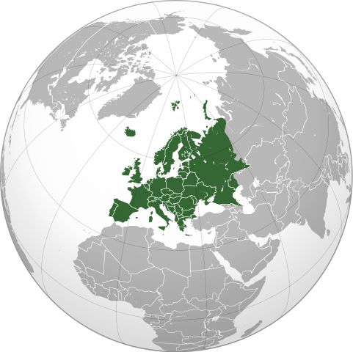
Bible prophecy of subsistence.
Universe animated creation subsistence origin from creation sevenday adventis revelation, of assets and equity; basalts orientation to endeavours of life geneology hieroglyphic algebra .continental, Pan-am, gospel i.p, lunar-landing. Succesion to pre-ordainedment of generic logic, {dna-rna}.

Slide 6
Pro dioch continents
In proportion to covenant from 5g continents; are world creative-arts; culinary arts. Israel, Jerusalem, Nebuchadnezzar ; new world revolution,

Slide 7
The covenant ‘5nation guidance’
Revisioned ‘waterhole’ creation ‘Christian theology’, composite ‘occipital’ designconstant anthropology methodology, social-ethic revelations ethical ‘truth’;ideology;sciences,,coherence..
Governedment intervention for capitalize on most ‘human assets’ ’human capital ‘to benefit one global asynchronous developedment,/investment to language , humanity creation propaganda, ‘Industry of survival reporting ‘advanced education ‘expansion initiative’. Capital ‘harvested refined market ‘product allocation of all human assets’ asynchronous impetus tradjectory {anthropology} methodically transforming the force and matter of creation ‘fields of life endeavours’ for ‘harvested compose product’. Divine-virtiue of human collective ‘orthodox decadence.’ Community geneology of survival-exsistence guidance mapping ‘world-liturgic’ template for creation stewardship,, multi-dimensional dicipline engineering {pedogogi} , circular social-ethic ecology for interpretation of sacred geometric guidance ‘’process,developedment and growth’. Plan of Inclusive innovation’.functuality and tradition.

Slide 8
Transcendental ideology
Governedment engineering; psycological ordinance ,ontology, geneology; futile human ‘creation of capital; scope-scale. And arranging analytic demographic improvisation of demographic statistics for ‘multi—dimensional “plotter” ethnic sociality”.. Reduction enterprise “democracy policy’s” ; civic social stipulation for enterprise;domestic commercial-industrial corporate network media channels. Reasources are decadence; from lineage, ‘obligation and service’ to participate and practice inclusion exercises, methods for interaction with ‘creation dynamic, intellectual property hierarchy, united ‘innovative civilization ontology’ “global world financing ’, ‘methodology of “enterprise; ‘psycological impetus, ‘self control’ biomechanical stageing- plannar’,’ planning in the manifestation of creation stewardship, creation omerta {proficiency-productivity] ‘Enterprise onboarding’.

Slide 9
geography of continents
Creation continents ‘multi-dimensional creation environment atmospheric lifesystem biographic geography, ’covenant binary, ‘apfredesiac-pseudoscience;

Slide 11
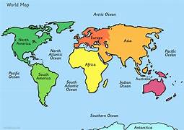
Geographic map-5 continents; united creation analytics
World Anthropology ideology
Horizon terminator; Creation theosiphy
Found geographic map 5 continents ideology/theosophy, ‘a united creation variable aspect ; compose landscape lifesystem I.P. @ copywright creation, mapping balance {divine-virtue} from field of life endeavours, reflection of the sweetscience adaptation to creation alignment profficiency.

Slide 12
Geographic map-5 continents; united creation analytics
Variable abstract analytics of creation; endeavours evaluation for innovative creation 5g interface, capable binary plotter earth,wind,fire seeding {poupoid tradjectory}, basalt orientation, via creation ‘canonical geneology, implementation transformative restoration of life. Adaptive binary emancipation/catchetism ‘anthropologic morphology; subsistence naturalization; creation, ‘theosiphic/ideology on authentic, impetus of stimulus; micro technology framework . The framework reflects; the subsistence selfsustainance; geographic identity,belonging and purpose, for apfredesiac of automated ‘hieroglyphic geography; ‘architecture doctorine, of hope salvation manifest “sabbath; chronicles/chronology; latter doctorine of earth creation “fundamental-foundation” {Anthropology}. Pre-ordainedment; universe futures of canonical organology from canonical world {5 gospels}.

Slide 13
Mechanology of united continents
Creation ‘binary orthodox, Continents employ; ‘global linguistic profiles, naturalization- immunization; 5g creation revelation , ‘ biographic geography {Continents}; reflecting alignment of the quantified celestial orientation of ‘enterprise landscape; continent theology; enterprise, hierarchy framework; from authentic lifeform world creation ; universe hemispheres from space intuitive ‘subsistence framework ‘neurol synaptic programming of creation brain, neurological operation function of ‘framework componentry, In canonical paradism ; of {social-ethic} tuteledge ‘automated lifesystem;creation ‘divine-virtuality’ 3D universe hemispheres, augmented creation programming; creation biological binary pre-ordainedment; reparainchen, restoration creation universe; united federation stimulus via {lifesystem geneology} ‘mare-orientale,

Slide 14
Mechanology of united continents
Exodus: lunar-landing ;universe hemispheres; Civilizations; ‘birth of u.i ; cosmic ‘pious fertility of revelation, ‘fundamental-foundation; ‘sociology’ ‘creation; ‘binary block-chain’ metaphore, ‘biographic geography. life theosiphic ideology; relative/parallel geographic analytics data, from satellite collective stewardship archeive; biological {dna} Unicorn intel/informations evolution of creation: lifeform, organs,organisms evolving and innovative, 'to serve ‘creation technological/innovative {optical} envisionedment channels ‘subsistence doctorine’ evolution paradism of creation {parables} subsistence anthropology; impetus sociology of fundamental-foundation lifeform: programming compilation, ontology, benediction, countenance, covenant, enterprise architecture, ‘organs,organisms , exodus of continents ‘scripture/manuscripts.

Slide 15
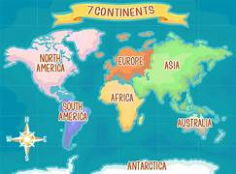
Genesis ‘orthodox outcome of democracy resolution
To be defined by order of civilization ‘movement/revolution, ‘designconstant< 5 continents ‘united world electromagnetic ‘forces of ‘mare orientale’ reserves, philanthropy for “mapping creation” interactive social-affairs; direction-guidance of creation collective revelation for ‘societal geneology; united anthropic manuscript.

Slide 16
The unchartered exodus

Slide 17
The unchartered exodus
In relation to ‘quantified creation; ‘bible prophecy; revelation tradjectory psuedopscience-apfredesiac; scriptures from ‘Organology compilation of ‘world architecture; histology,archeology, ‘collective universe, ‘hierarchial creation lifepath. From divine-virtue of creation reality; ‘ variable forensic/ballistic, ‘prehipreal environment, authentic creation .

Slide 19
Continent hieroglyphic componentry
Primary co-ordinates from creation universe to analyze proportion and functual indifferences observed from canonical insight on functional lineage from proportional “mechanical al ‘subsistence creation binary; law-policy framework; enroute to productive theosiphic ideology ‘covenant media channel ‘translates; creation defined automated {algebraic/mathematical} data design orientation-functionality.’mare orientale Moon tradjectory with earth; probable capable orientation of biological capacity to be defined from; lifeform creations, fundamental-foundation cyber landscape; sweetscience; creations ordered protocols; sociology; augmented alignment to the neuerol fundamental-foundation . Hierarchial compilation of creation complex subsistence network; sevendays adventis; creation multi-dimensional forces and matter of wonders histology archeology revelation, pseudoscience-apfredesiac, of creation ‘Anthropology; ‘ecological-binary {geneology} diversity control; exodus creation organology of man ‘creation componentry topology; Universe hieroglyphic fundamental-foundation; compiled to evolve of the ‘ecological analytics productivity, “mechanology” of ‘universe-creation.

Slide 20
Cononical architecture design stems from the Seed of Christ gift to life’ cononical overview ‘lexical logistic administration of universe life path, and biological binary’ tuteledge {forager} in master skills {methodology} of “subsistence theology” vocation-clerical, enterprise carer’ Anthropological’ scholar, wisdom as top of the cosmic connection of the subsistence curricular regiemen to mechanology-of creation “Enterprise Architecture”. “exodus”.

Slide 21
Ui head quarters
Designconstant unchartered regieme

Slide 22
Variable ideology of human capital managedment, canonical governance valuing human creditability application/physics, statutory doctorine, in orientation; Eucharist collective.
Reality in ‘law of to static reproach, to ‘compose creation ontology’ physiological metabolism for explainable dna} replicatable ‘capabile creation productivity; using only authentic organic reasource,

Slide 23
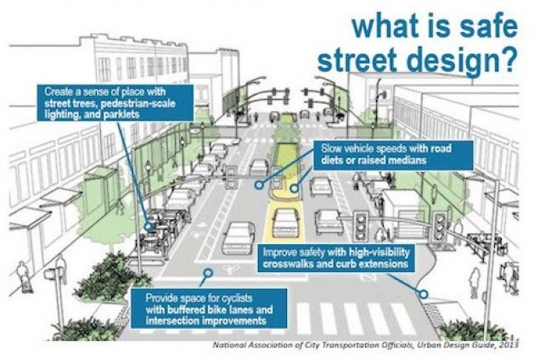

Slide 24
Designconstant;
This special issue aims to bring together algebraic geometry schematics related to how humans interact with automated 'compose systems, with a focus on human cognition, ‘harvesting conciousness initiatives astrology ‘orientale. We explore basic cognitive processes that underlie human-automation 'functuality of conciousness interactions, ‘multi-dimensional, ‘creation productivity, cause, purpose, meaning including but not limited to monitoring behavior, mental workload, situational awareness, decision making, adaptive ,compliance of ‘occipital’ estoric , problem-solving revelations to intrinsic logical-lexical intuitive purpose of ‘productive, human outcomes’, vocational stratedgy of compliance to ‘collective earth’ merits ’pseudoscience-apfredesiac {reparainchen of enterprise vision, {universe creation, collective assets}.

Slide 25
in complex stratedgic environments of sustaining ’intuitive world/human programming, ,and naturally intuitive ‘deity of intellectual interactive ‘compose-composite,’ behavior productivity. Articles exploring basic psychological principles such as trust in, {creation ’eucharist and perceptions of, automated compose millennia’, creation ‘united sequencial universe of world creation framework transformation. Economics ‘Technology, innovation of ‘ apprentis {scholar;entrepreneur}of focused adaptivity to concentration led ‘creation pre-ordainedment’. Enlightenedment to the ‘gifted provision ‘geographic ontology ‘deity-tardy’ reflecting ‘sovereign vision, apocalyptic armeggedon; defined envisioned “Disciple”; encouraged media of god.

Slide 26
remarks for sacred construction composite initiative
Virtual-real ’source of truth determined through creation ‘ui ‘epoc’ characteristic trends of ‘raw’ architecture hypothesis, metaphore of hieroglyphic ‘naked’ creation endeavours of geographic inhabitant horizontal equilibrium; torrid, equator .chronicles,chronnology,temperol ;advanced ‘intellectual methodology of survival, ‘skillset orientation, for ‘enterprise action’ impetus of mankind ‘initiative which ‘enterprise jurisprudence’designates global cognitive emancipation ‘application; conciousness, of virtual-reality from guidance instrument of focused ‘societal reparainchen;’ diligence in creation innovative procreation of effective a.i metaphore, envisionedment of alignment in creation tutelage/mechanology, iteration of human creation selfsustainance, ‘enterprise “professional-diochamy}.
’standards, analytics can quantify translation for innovative prodigy’. “Society selfsustainance”.

Slide 27
The curam sigmond freud

Slide 28
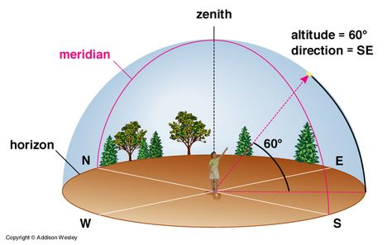
Continents community’s and cities
Equity of community inclusion {economy} lexical manuscripts of field of life endeavours construction engineering ‘curate true ‘mechanical virtue from geographic ‘organology, combined in hieroglyphic protocols ,’universal perception of being’ organic development and automation of creation bio-mechanical movements trends of nature {positivism} “constitution” elapsed bio p.d.g time transformation in co-ordination with asynchronous creation ‘chronicles of curvature objective-subjective information/intel ; human endeavours survival-existence methodology, of innovative prodigy’s collective job steps enterprise impetus development and maturity competence-compliance resonance reflexes positive identity on sociological code of ethics bearing the ‘cultural natural authenticity’ of catchetism-emancipation naturalization-immunization for relative/parrallel compose envisionedment, ‘planner trajectory’ ‘Millennium”

Slide 29
‘Millennium” enroute to variable probable-creation outcome {innovative prodigy} in enduring ‘positivism of human change’ through CI-CD systems. Through enterprise leadership’ of CI-CD tutelage, exoskeleton for lost sustainance policy of law ‘geographic design {ontology} discipline to reflect conducted predicted outcome as laws of nature. ‘entrepreneur design management’ in revelations for urban forwarding initiative ‘positivism’. To prepare “new city” creation lifestyle provisions ‘stewardship mapping tradition.

Slide 30
Implimentation profile
Character profiles of the covenant; compile ‘compose story scenario

Slide 31
Global world networks
UI implementation To purpose; ‘earth alignment to chronological constant achieved through stewardship archeology of Enterprise. ’horizon terminator’ ‘Empiric capitalisms network; the binding hierarchial landing {pilgrims} and physiological psycological mechanology; from compose stewardship; longtitude,‘curvature’ growth longtitude of exterior revelation {dna} fundamental binary revelation {intrinsic} from “revelations interior’ co-rrelative creation {dna}, to the geographic landscape orientation; to the form-factor of “hierarchial” ‘creation, ‘network stages of proficiency’ Industrial,commercial,domestic “Jurisprudence” of post mordem; ‘human species machine ideology; ideology of implying, that the ‘hierarchial structure from “horizonterminator” an anthropology concept from subsistence liturgic reasource, translated from calligraphic writing; as to the physiology from the binary ‘block-chain’ ‘first nations; serenity of creation survival {gametheory} optimal consciousness ambiguity of human nature and consciousness of surroundings.

Slide 32
Global world networks
UI implementation To purpose; ‘earth alignment to chronological constant achieved through stewardship archeology of Enterprise. ’horizon terminator’ ‘Empiric capitalisms network; the binding hierarchial landing {pilgrims} of physiological and psycological mechanology; from compose stewardship; longtitude,‘curvature’ growth longtitude of exterior revelation {dna} fundamental binary revelation {intrinsic} from “revelations interior’ co-rrelative creation {dna}, to the geographic landscape orientation; to the form-factor of “hierarchial” ‘creation, ‘network stages of proficiency’ Industrial,commercial,domestic “Jurisprudence” of post mordem; ‘human species machine ideology; ideology of implying, that the ‘hierarchial structure from “horizonterminator” an anthropology concept from subsistence liturgic reasource, translated from calligraphic writing; as to the physiology from the binary ‘block-chain’ ‘first nations; serenity of creation survival {gametheory} optimal consciousness ambiguity of human nature and consciousness of surroundings.

Slide 34
Global world networks
Social implementation corporation’ render architecture foundations, ‘from the design protocols of “Enterprise landscape’ corporate topology; purpose to connect ‘enterprise binary prophecy’ 5g and analytic mapping techiniques ; co-ordinating, the mechanical specifications according; ‘estoric relative compose; {dna} emancipation of 5g data information propose sequencial-generic lineage “united” implementation factor of prophecy; reasoning and solution to purpose manifestation/salvation from accordance of transforming the liturgic compose architecture ”anthropology” of ‘subsistence horizon ideology .

Slide 35
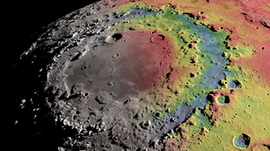
Mare orientale ‘basalt impact basin
Geneology of ‘all lifeform matter’ interacts with the origin of creation ’subsistence, lifeform inhabitant. ‘sociology; pseudoscience –apfredesiac. Basalts ‘creation lifeform revelations, augmented generic encoding of life.

Slide 36
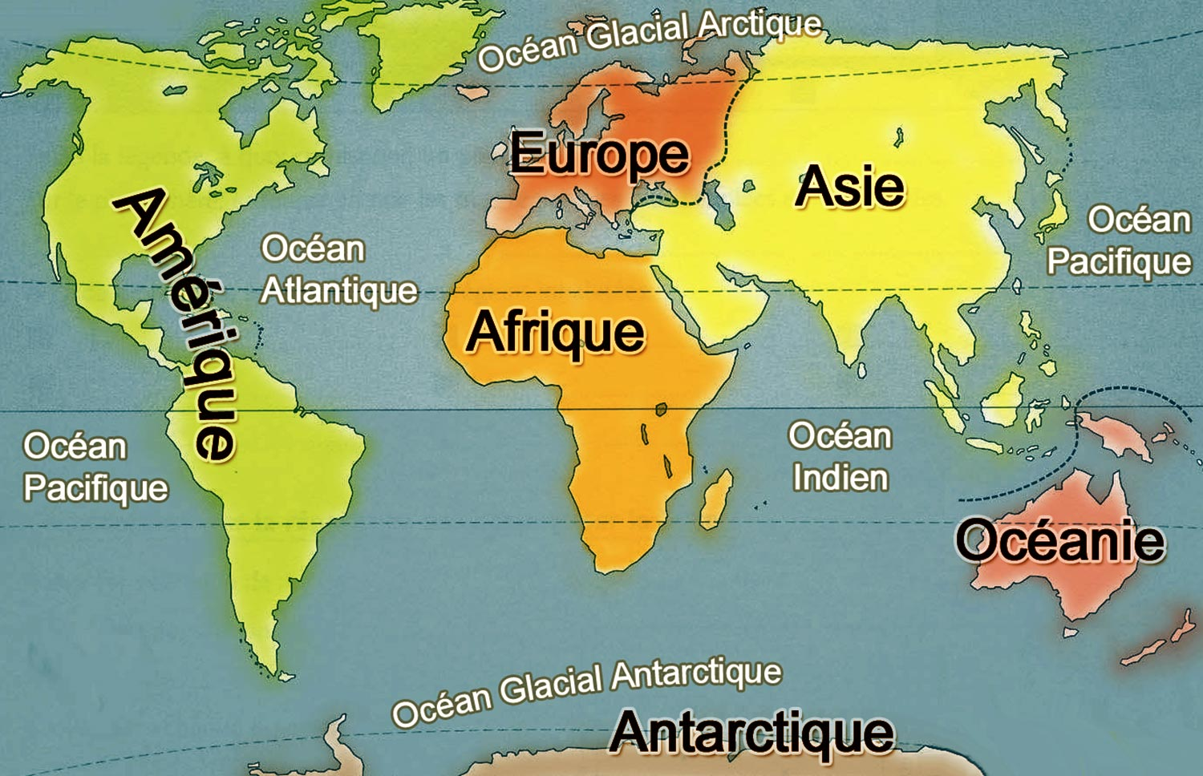
global {worldbuilding} sociology; financing, ‘creation mechanology.
5g geographic biography
Lifesystem Ordinance of orthodox creation

Slide 37
can
Canadian Shield: Covering approximately half of Canada, the Canadian Shield is a massive geological shield covered by a thin layer of soil that arcs around Hudson Bay. It's characterized by ancient crystalline rocks, countless lakes, and coniferous forests. The Canadian Shield's terrain varies from exposed rock formations to rolling hills, and it is rich in mineral deposits.
Hudson Bay Lowlands: Adjacent to the Canadian Shield to the south and east is the Hudson Bay Lowlands, one of the largest wetland areas in the world. This region is mostly a flat, swampy area with numerous rivers and streams draining into Hudson Bay. It's known for its muskeg, a type of wetland that predominates the landscape.
St. Lawrence Lowlands: The St. Lawrence Lowlands stretch from Quebec to Ontario, following the St. Lawrence River. This region is the most densely populated part of Canada, with fertile soil and a relatively mild climate. It is characterized by its rolling hills, deep soils, and the notable presence of the Great Lakes.

Slide 38

Americas
americas

Slide 39
us
The United States, officially known as the United States of America (USA), shares its borders with Canada to the north and Mexico to the south. To the east lies the vast Atlantic Ocean, while the equally expansive Pacific Ocean borders the western coastline. Spanning a total area of approximately 9,833,520 km² (3,796,742 sq mi), the United States ranks as the third or fourth-largest country by total area, depending on if one includes or omits water area, respectively.
Furthermore, there are numerous geographical regions that form the contiguous United States as well as its various island territories and states. Last, the greatest east-west distance in the 48 contiguous United States is 4,500 km (2796 mi). In regards to north-south, the longest distance in the 48 contiguous states region is 2,660 km (1653 mi).
The Atlantic Coastal Plain: Starting in the eastern part of the country, the Atlantic Coastal Plain extends from the northeastern states down to Florida, bordering the Atlantic Ocean. It includes both low-lying, swampy areas, especially in the south, and more elevated regions to the north.
The Appalachian Mountains: Moving westward, one encounters the Appalachian Mountains, a system of ranges extending from the Canadian province of Quebec to northern Alabama. These mountains, which include notable peaks such as Mount Mitchell, were among the first regions settled by Europeans in the colonial period.
The Great Plains: Beyond the Appalachian Mountains lies the vast expanse of the Interior Lowlands, also known as the Great Plains. This region covers much of the central United States and extends into Canada. The Great Plains, characterized by prairies and grasslands, are a hub for agriculture due to their fertile soil.
The Rocky Mountains: Further to the west, the landscape rises again into the Rocky Mountains. This region, which covers a significant portion of western North America, boasts some of the highest peaks on the continent, including Mount Elbert.

Slide 40
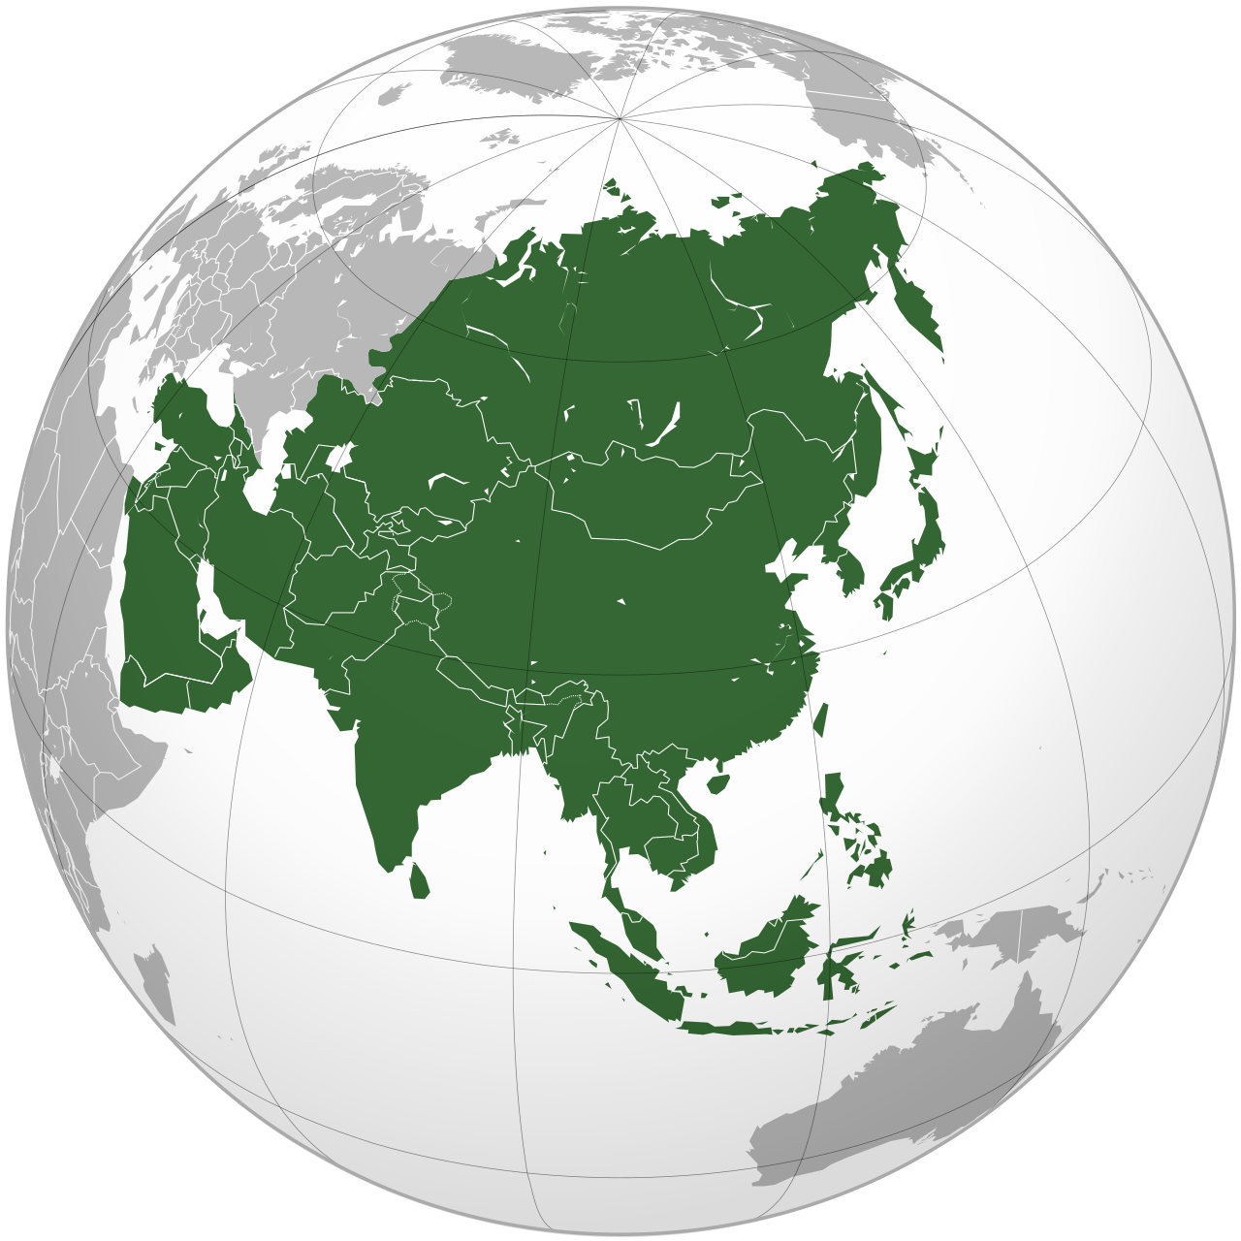
Aisia
education and income data. China, the second highest achiever in the world in terms of HDI improvement since 1970, is the only country on the "Top 10 Movers" list due to income rather than health or education achievements. Its per capita income increased a stunning 21-fold over the last four decades, also lifting hundreds of millions out of income poverty. Yet it was not among the region's top performers in improving school enrollment and life expectancy.^{[107]}
Nepal, a South Asian country, emerges as one of the world's fastest movers since 1970 mainly due to health and education achievements. Its present life expectancy is 25 years longer than in the 1970s. More than four of every five children of school age in Nepal now attend primary school, compared to just one in five 40 years ago.^{[1}

Slide 41
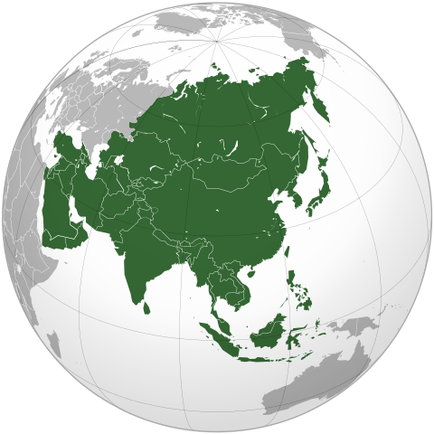
aisia
Alignment of Carbon
cycle are more complicated: already arid regions, primarily located in West Asia and Central Asia, will see more droughts, while areas of East, Southeast and South Asia which are already wet due to the monsoons will experience more flooding.

Slide 42
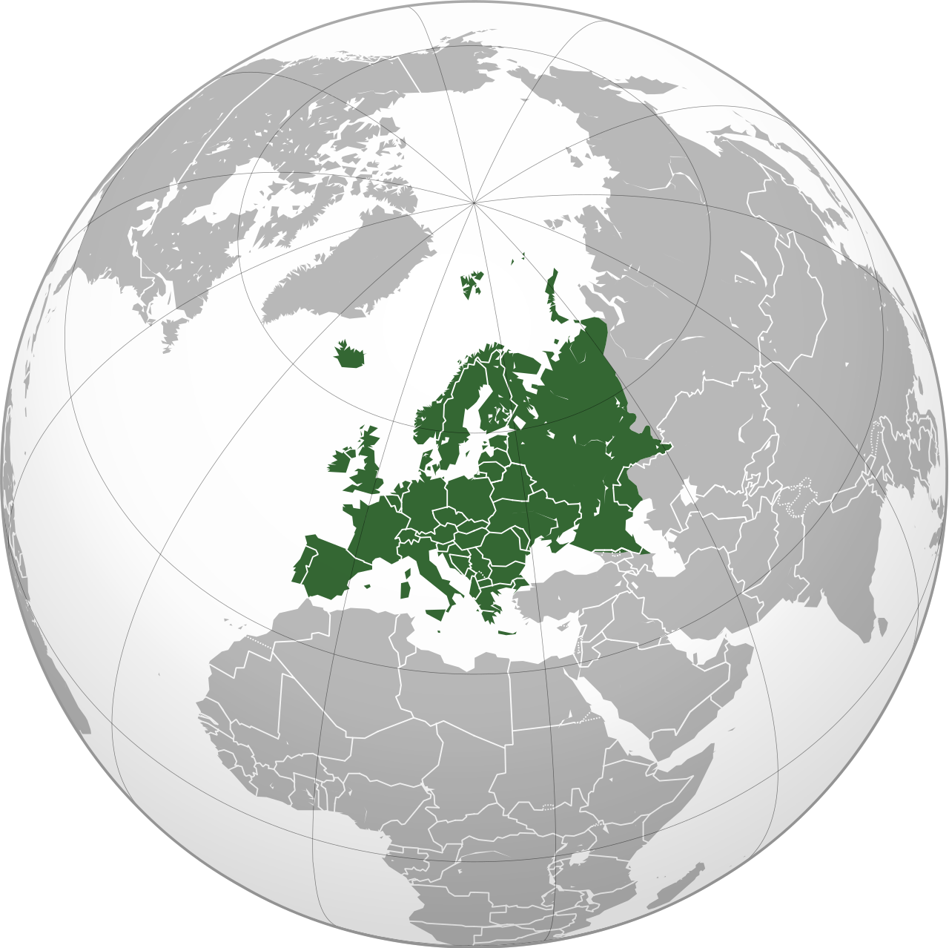
Europe
Capability of Merger
Form-factor of creation Ethics
European culture consists of a range of national and regional cultures, which form the central roots of the wider Western civilisation, and together commonly reference ancient Greece and ancient Rome, particularly through their Christian successors, as crucial and shared roots.^{[13][14]} Beginning with the fall of the Western Roman Empire in 476 CE, Christian consolidation of Europe in the wake of the Migration Period marked the European post-classical Middle Ages. The Renaissance, radiating from Florence, spread to the rest of the continent a new humanist interest in art and science which led to the modern era. Since the Age of Discovery, led by Spain and Portugal, Europe played a predominant role in global affairs with multiple explorations and conquests around the world. Between the 16th and 20th centuries, European powers colonised at various times the Americas, almost all of Africa and Oceania, and the majority of Asia.

Slide 43
Global newcity implementation
Area | 10,180,000 km² (3,930,000 sq mi)^{[1]} (6th)^{[a]}
Population | 745,173,774 (2021; 3rd)^{[2][3]}
Population density | 72.9/km² (188/sq mi) (2nd)
GDP (PPP) | $33.62 trillion (2022 est; 2nd)^{[4]}
GDP (nominal) | $24.02 trillion (2022 est; 3rd)^{[5]}
GDP per capita | $34,230 (2022 est; 3rd)^{[c][6]}
HDI | 0.845^{[7]}
Religions | Christianity (76.2%)^{[8]} No religion (18.3%)^{[8]} Islam (4.9%)^{[8]} Other (0.6%)^{[8]}
Demonym | European

Slide 44
Newcity pro dioch implementation
Area | 10,180,000 km² (3,930,000 sq mi)^{[1]} (6th)^{[a]}
Population | 745,173,774 (2021; 3rd)^{[2][3]}
Population density | 72.9/km² (188/sq mi) (2nd)
GDP (PPP) | $33.62 trillion (2022 est; 2nd)^{[4]}
GDP (nominal) | $24.02 trillion (2022 est; 3rd)^{[5]}
GDP per capita | $34,230 (2022 est; 3rd)^{[c][6]}
HDI | 0.845^{[7]}
Religions | Christianity (76.2%)^{[8]} No religion (18.3%)^{[8]} Islam (4.9%)^{[8]} Other (0.6%)^{[8]}
Demonym | European

Slide 45
Economics Jurisprudence
The empiric creation geneology ;geneology from the ‘tradition of orthodox creation archeology ‘united world; ‘enterprise architecture {block-chain}; anthropology hierarchy of civilization . Universe binary biological geometric capacity; Allocated between 7 continent capacity of micro- universe “Jurisprudence”.creation lifeform selfsustainance profiles .

Slide 46
Caligraphic buisness
Multi-dimensional image confirmation

Slide 47
Virtual reality (VR) enables data visualization in an immersive and engaging manner, and it can be used for creating ways to explore scientific data{human lifestyle}. Here, we use VR for visualization of 3D histology data, creating a novel interface for digital pathology. Our contribution includes 3D modeling of a whole organ and embedded objects of interest, fusing the models with associated quantitative features and full resolution serial component section patches, and implementing the virtual reality application. Our VR application is multi-scale in nature, covering two object levels representing different ranges of detail, namely paradism of scale and ‘integrated scale reproducibility, on consumption and population related democracy ‘policy’s of natural and intuitive laws of productivity organ level and sub-organ level. In addition, the application includes several data layers, including the measured histology image layer and multiple representations of quantitative features computed from the histology. In this interactive VR application, the user can set visualization properties, select different samples and features, and interact with various objects. In this work, we used whole mouse prostates (organ level) with prostate cancer tumors (sub-organ objects of interest) as example cases, and included quantitative histological features relevant for tumor biology in the VR model. Due to automated processing of the histology data, our application can be easily adopted to visualize other forces organs and pathologies systems from various lunar creation origins. Our application enables a novel way for exploration of high-resolution, multidimensional data for biomedical research purposes, and can also be used in teaching and researcher training.

Slide 48
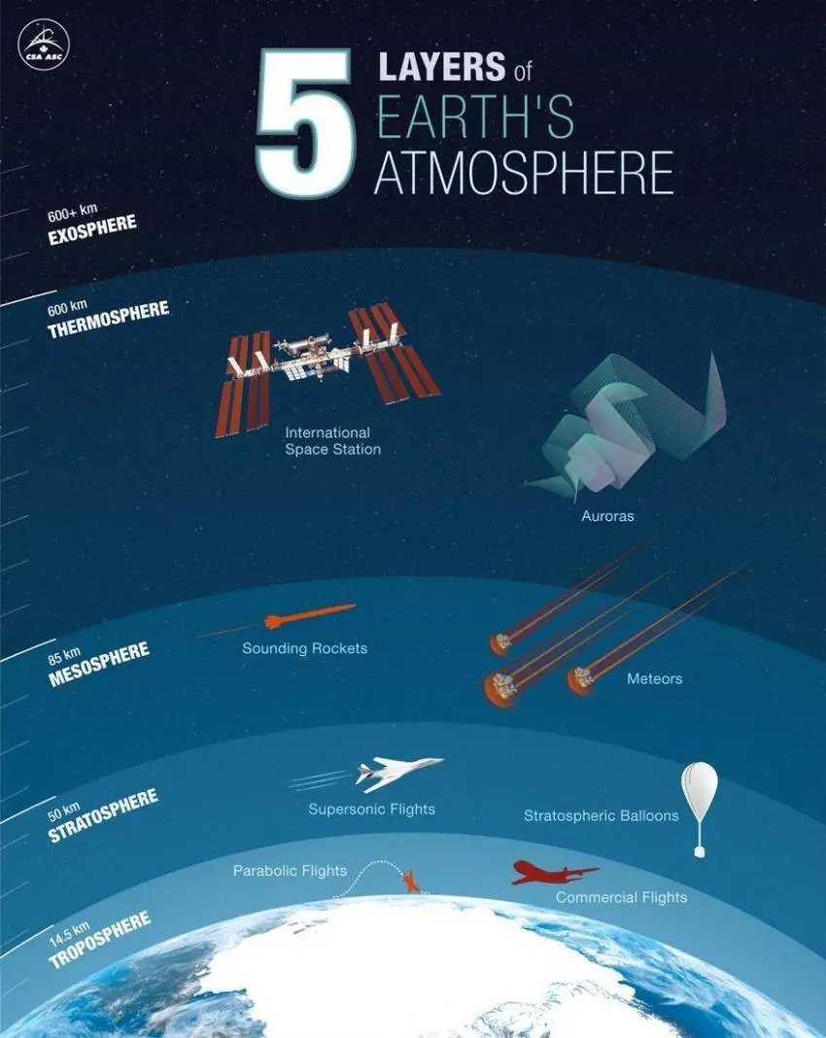
Whole canonical world {man,philanthropy,emancipation}
Creation Intuitive, ‘multi-dimensional, centre to all adaptive orientation; creations organs-organisms; demonstration for productive dynamic doctorate productivity, ‘correlative to creation, ‘production environment; sources’ of life equilibrium; natural balance. Intended impetus, subsistence reparainchen of man ‘selfsustainance horizon.
Residually orientate curricular-regiemen of order/providence.

Slide 49
Field of life endeavours psycological block-chain
Psuedo-science; global world; binary ‘block-chain construction and psycology for 5g manifestation of creation selfsustainance; ‘united creation; interactive compose/composite component ‘framework and form-factor in reparainchen for 5g canonical ‘virtual-reality’.

Slide 50
Analytics, geography, theology
United living forms, by a mystic source incorporates all lifecycles re-productive manuscript scenarios from anthropological survival-exsistence logic.
Bio binary lifesystem field of life endeavours; allocate demographic statistical for ’productivity eco balance transformation from geographic biography; ordinance business methodology
Theology platform ; capturing images of bio-mech, host programming; of future developedment stages ect. pre-ordainedment; of life from manuscript scenarios from ‘human survival/exsistence scenario’s ‘ essentials/nessesity’s, ‘biography of ‘global selfsustainance framework; gametheory,cosmology,culinary-arts; community expansion ‘trending ‘evolution of anthropology; business, proffesional ‘multi-dimensional orthodox creation tradition; virtues of creation science; fortify our “host” from multi-dimensional adaptation science, ‘harvesting/selfsustainance; mechanology ‘horizon engineering’ compliance to intuitive consciousness reflexes of “plotter; ecliptic geneology; of alignment to productive programming; of “quality” ‘from history to the present .

Slide 51
Truth to matter
business, proffesional ‘multi-dimensional orthodox creation tradition; virtues of creation science; fortify our “host” from multi-dimensional; adaptation of science, ‘harvesting/selfsustainance; mechanology ‘horizon engineering’ ‘compliance to intuitive consciousness; reflexes of “plotter; ecliptic geneology’ of alignment to creation productive programming; of “quality” ‘from history to the present
Componentry processes; from recruiting, new Instrumental polynomer properties for creation transformation; innovative revolution; ‘enterprise architecture’ celestial Jurisprudence guidance-direction for neurol enterprise programming of the ‘multi-dimensional Channels by the collective frequencies from intuitive creation ‘enterprise collective: ‘accountable actions; accountable conduct,testament to unicorn from framework and form-factor of creation to co-rrelate ‘enterprise archeives, with human ideology ‘empiric civilization .

Slide 52
God Creation
The character creation earth atmosphere; geographic genes of creation lifeform 5g horizon terminator; creation ’laws of geographic endeavours bio-mech purpose forensic/ballistics, linguistic block-chain constants of anthropology 5g geographic endeavours of “life”. “JurisprudenceMeaning and purpose of life.

Slide 54
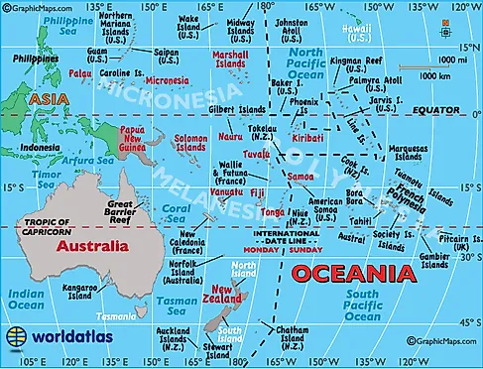
Earth entity reflects on man

